Slide 1
MESOPOTAMIAN CIVILIZATION
Dr. Md. Faruk Shah
Adjunct Faculty Member
Department of History and Philosophy
North South University

Slide 2

Lecture Outline
Background of Mesopotamian civilization
Religion
Government system
Social structure
Economic condition
Women's’ status and marriage
Chronology and Medicine

Slide 3
MESOPOTAMIAN CIVILIZATION: “The Cradle of Civilization”
Earliest of all civilizations which lasted for 3000 years.
It was known as the “Cradle of Civilization” as the birthplace of civilization.
Mesopotamia is the Greek word used for “land between the rivers.”
Originated between the Tigris and Euphrates River valleys.
Water supply from the rivers ensured agricultural production.
Geographically it is located in modern day Iraq.
Mesopotamia civilization was a combination of agrarianism, city life, government, trade networks, and writing invention.
https://www.youtube.com/watch?v=xVf5kZA0HtQ
https://www.youtube.com/watch?v=KY05g30v2Xo
https://www.youtube.com/watch?v=J1GF_8l97xU

Slide 4

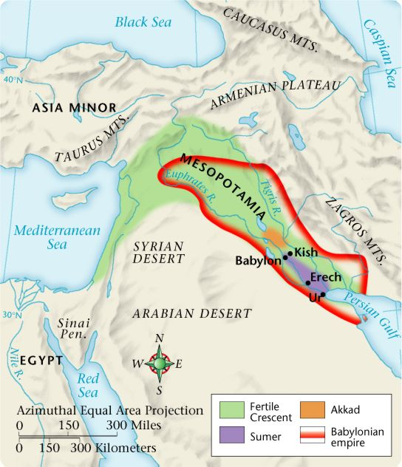
Map of Mesopotamian Civilization

Slide 5
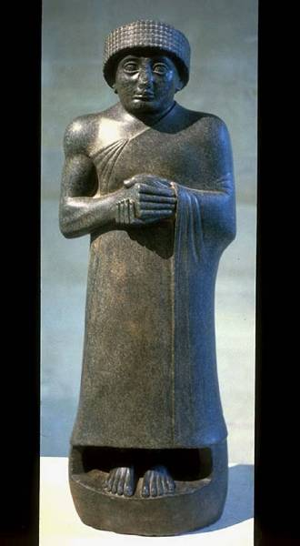
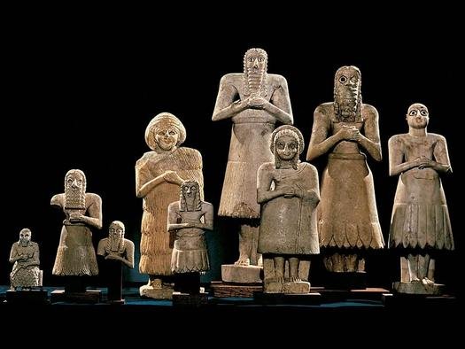
Religion: The Basis of Mesopotamian Civilization
Religion was at the center of Mesopotamian life.
It dominated and inspired human activities.
Four major Gods controlled the whole world
Worshiped many gods
God directs everything
Priests held high status
Gods were viewed as often hostile and unpredictable
To keep the gods happy, each city built a temple

Slide 6
Religion: Role of Major Gods
Enlil: supreme god & god of air
Ishtar: goddess of fertility & life
An: god of heaven
Enki: god of water

Slide 7
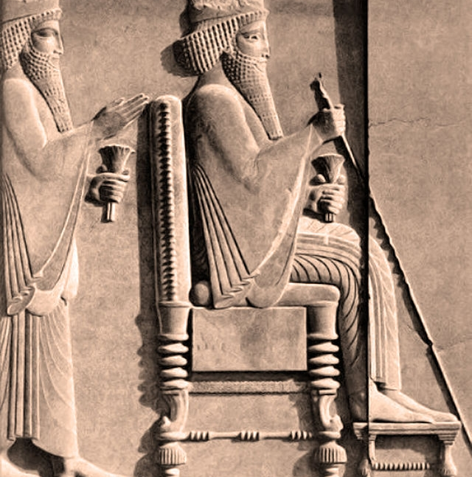
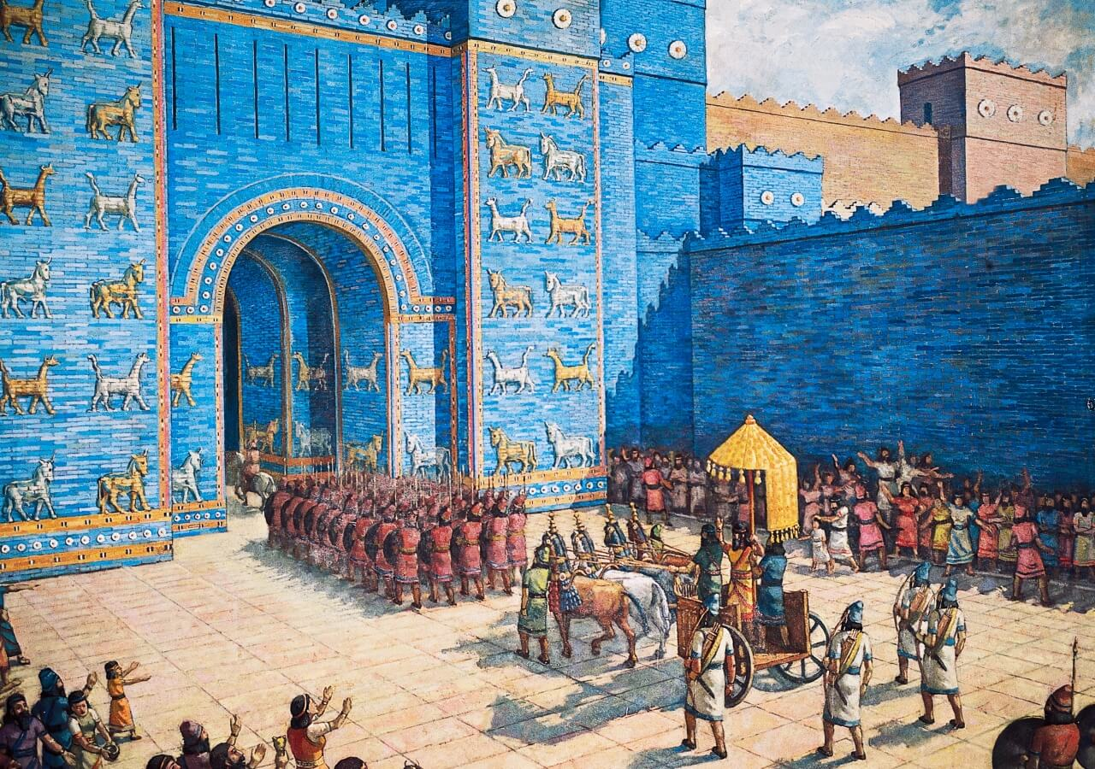
Government System
Theocracy: rule by gods or their priests
Kings received their power from gods
Noble officials and priests assisted king to rule the cities
City-states run by hereditary rulers
Ruler led army in war and enforced laws
Government collected taxes and kept records

Slide 8
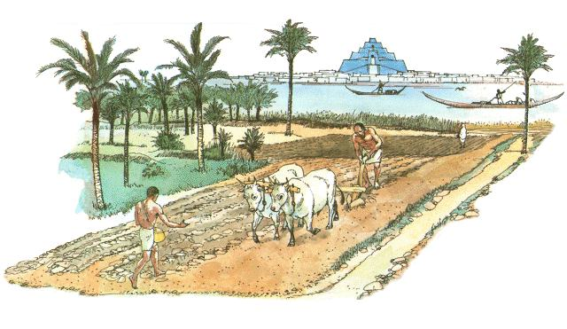
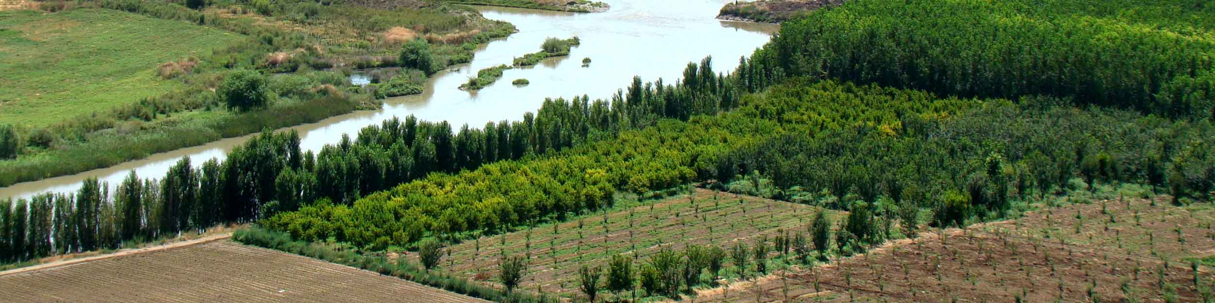
Earning a Living
Most people were peasant farmers.
Shopkeepers, clerks and casual laborers were also available.
Economy based on farming and trade.
Inventions of irrigation systems, the plow, the wheel/cart.
Turned the dry valley into a prosperous center of agriculture supporting many people.
A large number of trades was connected with the production of clothing and textiles.
Also people involved in the preparation, distribution, and sale of food. (Adler & Pouwels, 2001).

Slide 9
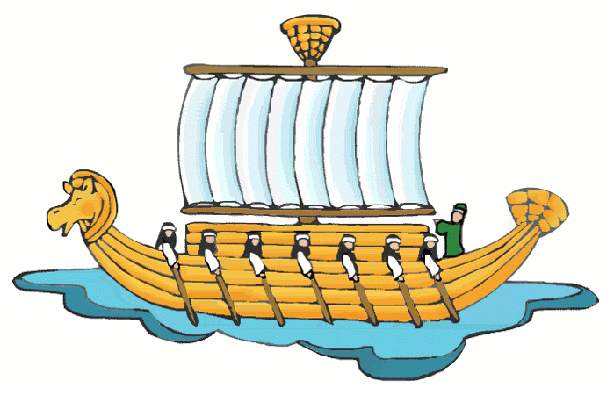
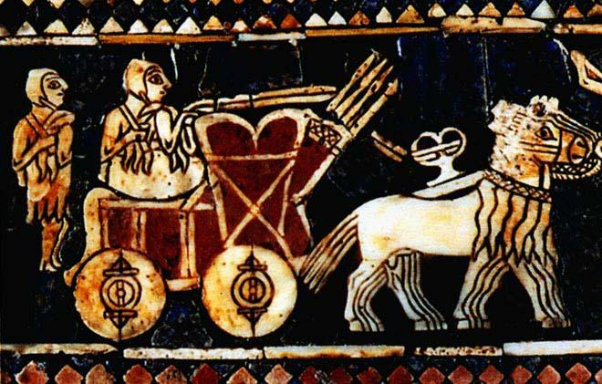
Trade and an Expansion of Sale
Trade grew rapidly
Traded grain, cloth and crafted tools for the stone, wood and metal

Slide 10
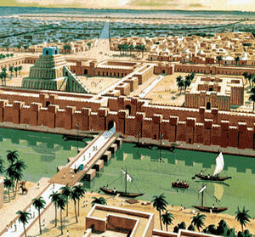
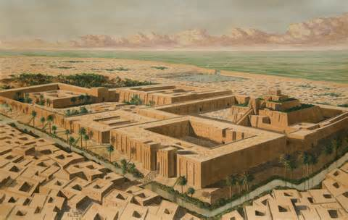
Physical Structure of City
Surrounded by walls, built with sun-dried bricks
Large government and house buildings
Used mud bricks

Slide 11
Social Structure
Priest and later Kings
Wealthy merchants and traders
Farmers & artisans
Slaves & noble landlords, the freemen

Slide 12
Women’s Rights and Marriage
Women had power and social prestige
Practice of egalitarianism was undermined
Husband was the head of the household
The trend was toward patriarchy
Marriage was always arranged by the two families
Children and family continuity were the main reasons for marriage
Women did have certain legal rights: could divorce husband

Slide 13
Law System
Punishment depended on the social rank of the violator
Offenders were subjected to the same damages or injury they caused to others.
People were not equal before the law.
Husbands had a great deal of power over wives, fathers over children, rich over poor, free citizens over slaves. Nevertheless, a definite attempt was made to protect the defenseless and to see that all received justice.

Slide 14
Chronology and Medicine
Sense of time was shaped by the cyclic nature of seasonal change.
The year was based on the passage of seasons
Calendar was subdivided into months, corresponding to the period between one full moon and the next (Adler & Pouwels, 2001).
Believed that gods or demons caused disease.

Slide 15
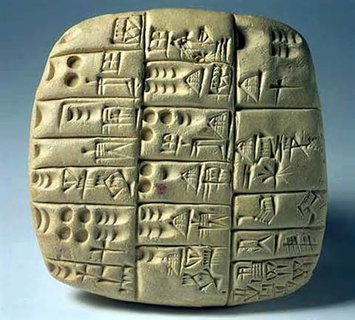
The Evolution of Writing
Developed a system of writing for:
keeping calendar and predicting seasonal changes
commercial and religious taxation
marital and inheritance contracts (Adler & Pouwels, 2001).
Scribes had a high place in society
Schools were called “tablet houses” and were used to educate
scribes for various governmental and commercial purposes.

Slide 16
The Decline of Mesopotamia in World History
Problems contributed to:
Long-term environmental degradation.
The cities’ food supply declined as the irrigated farms of the lower plains no longer produced abundant harvests.
The once-thriving city-states and rich fields were gradually abandoned, and the center of power and culture moved elsewhere.
With the coming of the Oil Age, that the area again became a vital world center.

Slide 17
Thank You and Questions???

